Slide 1
SUBMISSION 3
Execution Report and QA Findings
QA CLOSURE
Python QA Automation for Financial Services Sales Data Pipeline
82.4% PASS RATE
Validation window | 01 May 2026 - 30 June 2026

Slide 2
01 | OUTCOME
Executive decision snapshot
TOTAL CHECKS
PASSED
FAILED
TEST CASES
108
89
19
138
Stages 2-5
82.4% overall
16 High, 3 Medium
Execution workbook
NOT READY FOR RELEASE
Financial aggregates and executive reporting do not reconcile to independently recomputed fact-table truth.
Correct completeness and transformation issues, refresh summaries, and rerun affected validations before sign-off.

Slide 3
02 | EXECUTION RESULTS
Validation coverage by layer
Layer
Total
Passed
Failed
Pass rate
Source to Staging
45
37
8
82.2%
Staging to Data Mart
22
15
7
68.2%
Data Mart Aggregates
15
10
5
66.7%
Reporting Layer
26
24
2
92.3%
OVERALL
108
89
19
82.4%

Slide 4
03 | FINDINGS
Key defects and business impact
Retail: one source record missing in staging; one phantom record and one row-count mismatch in the data mart.
Online: duplicated staging key ONL000020, a one-row data-mart shortfall, five transformation mismatches, and 366 folio mismatches.
Distributor: one source-to-staging field mismatch and ten data-mart transformation mismatches.
Channel, daily, product, and region summaries fail reconciliation; executive reporting has 305 view mismatches.
Impact: incorrect totals, counts, average tickets, and product/channel/region comparisons can affect executive and operational decisions.

Slide 5
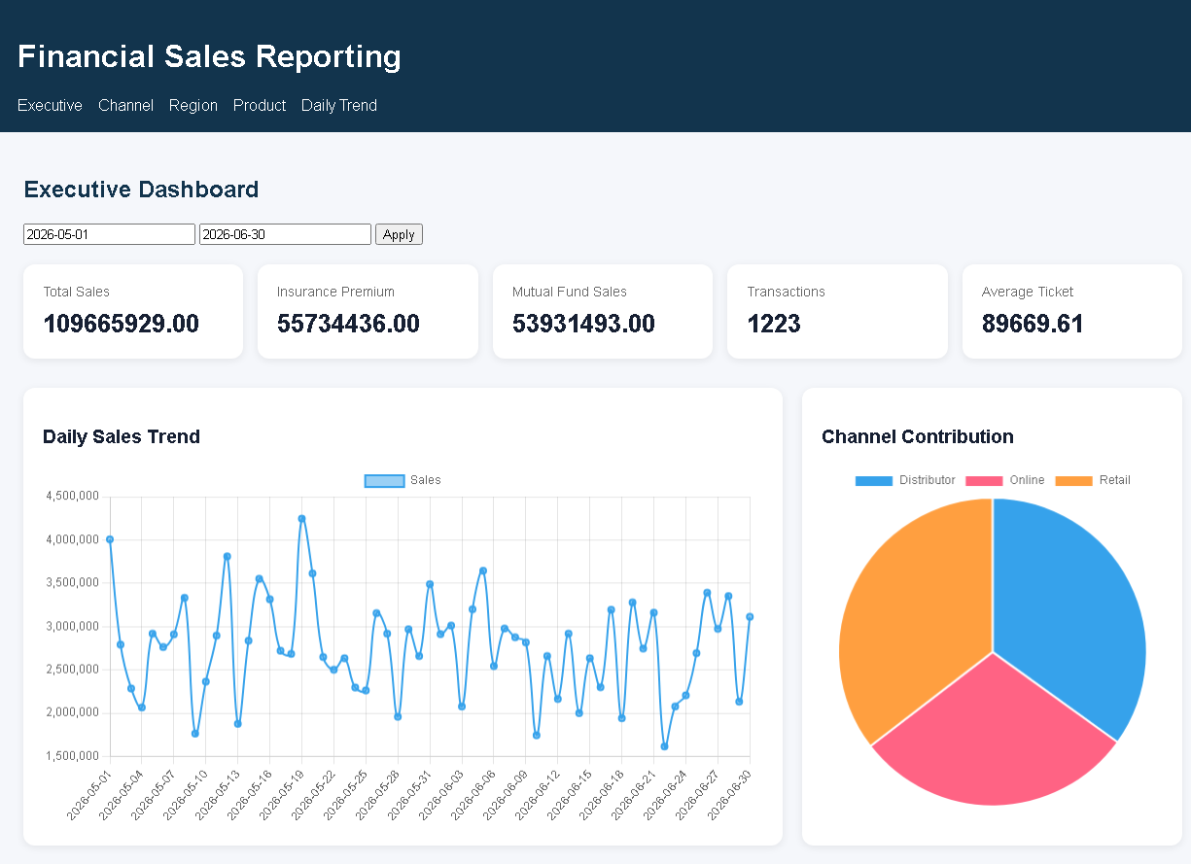
04 | DASHBOARD SAMPLE
Reporting evidence
Live executive dashboard captured for the configured validation window. Displayed metrics are retained as evidence and reconciled by the validation suite.

Slide 6
05 | NEXT STEPS
Recommended closure actions
Repair source-to-staging completeness, duplicate handling, and Distributor field mapping.
Reconcile transformation rules with the business specification, especially region, product, customer, and folio derivations.
Rebuild aggregate summary tables after fact-table corrections and compare them to independent recomputation.
Align reporting views and dashboard calculations with all-channel fact-table totals.
Add filter-combination validation and controlled retests for every resolved defect.
Exit criterion
No High-severity failures; all aggregate and executive metrics reconcile; retest evidence attached.

Slide 7
06 | TRACEABILITY
Submission evidence pack
Validation execution report: Excel workbook with QA Summary, Defect Log, and Full Results.
Completed defect log: standalone workbook with expected/actual, evidence, severity, root cause, and business impact.
Evidence ZIP: API health and sales JSON, read-only SQL outputs, dashboard screenshot, and failed-row CSVs.
Execution logs ZIP: timestamped Stage 1 and run-all logs.
Repository: github.com/Soumil630/talentfarm-etl-project
Submission folder
C:\Users\talentfarm_learner\Downloads\TalentFarm_Submission_3

